Slide 1
Deepfake Detector
Team Faux Fighters
Cho, Anna
Denq, Christopher
Nelson, Reid (Jackson)

Slide 2
Roadmap

Slide 3
Roadmap
Problem Statement

Slide 4
Roadmap
Problem Statement
Methodology

Slide 5
Roadmap
Problem Statement
Methodology
Analysis

Slide 6
Roadmap
Problem Statement
Methodology
Analysis
Conclusion

Slide 7
01
Problem Statement

Slide 8
—Elon Musk, probably
“AI is spook.”

Slide 9
PROBLEM
Generative AI makes it easy to deepfake.
Notes:
complicates public trust and undermines the epistemic integrity of visual media
spread false information, manipulate public opinion, and polarize communities

Slide 10

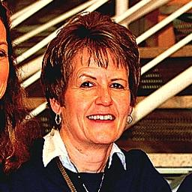
PROBLEM
Generative AI makes it easy to deepfake.
Deepfake
Real
Notes:
complicates public trust and undermines the epistemic integrity of visual media
spread false information, manipulate public opinion, and polarize communities

Slide 11
PROBLEM
SOLUTION
Generative AI makes it easy to deepfake.
We have “out-of-box” deepfake detector.

Slide 12
02
METHODOLOGY

Slide 13
01
“OpenForensics” dataset from a paper presented on computer vision
SOURCE

Slide 14
02
Data augmentation, size formatting
CLEAN
01
“OpenForensics” dataset from a paper presented on computer vision
SOURCE

Slide 15
03
Trained 11 CNNs;
Positive class = real
MODEL
02
Data augmentation, size formatting
CLEAN
01
“OpenForensics” dataset from a paper presented on computer vision
SOURCE

Slide 16
04
Best results: “out-of-box” solution!
RESULT
03
Trained 11 CNNs;
Positive class = real
MODEL
02
Data augmentation, size formatting
CLEAN
01
“OpenForensics” dataset from a paper presented on computer vision
SOURCE

Slide 17
03
ANALYSIS

Slide 18
Best Model
Eff.NetV2_B0

Slide 19
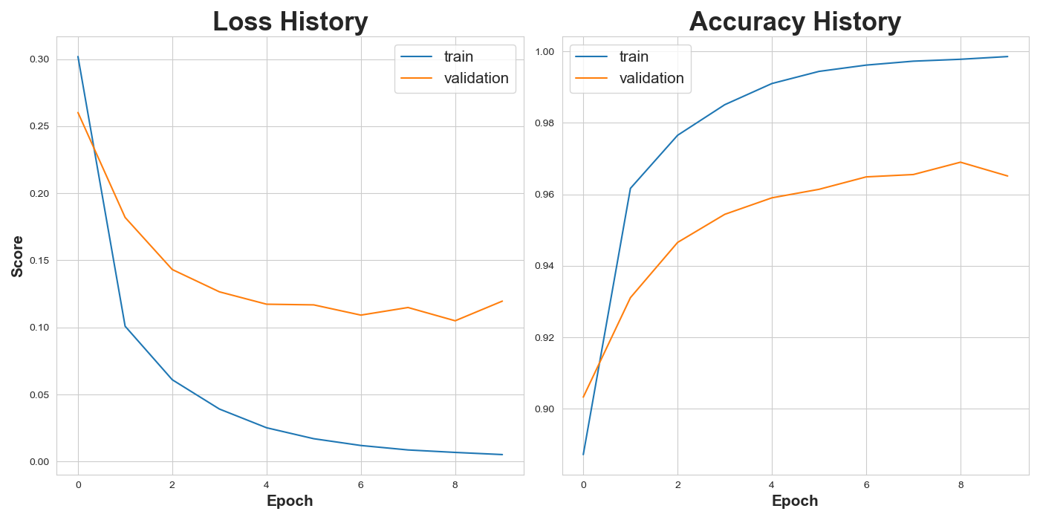

Slide 23
Overall Model Comparisons

Slide 24
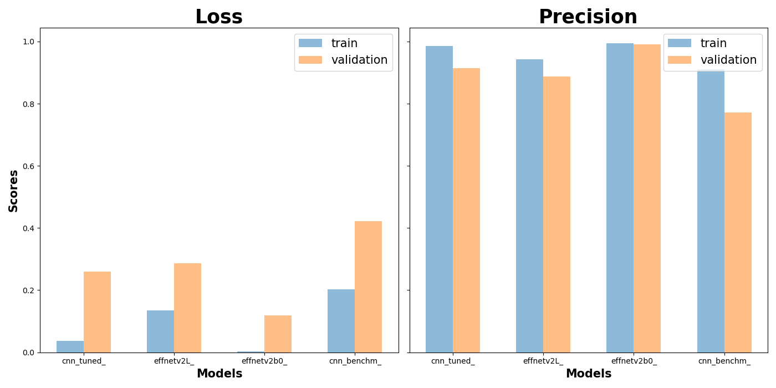

Slide 29
04
CONCLUSION

Slide 30
Best
Benchmark
Experimental

Slide 31
Best
Benchmark
Experimental
Sequential CNN (Base)
Acc: 0.860 | Prec: 0.849

Slide 32
Best
Benchmark
Experimental
Sequential CNN (Base)
Acc: 0.860 | Prec: 0.849
EfficientNetv2_L (TL)
Acc: 0.774 | Prec: 0.822

Slide 33
Best
Benchmark
Experimental
EfficientNetv2_B0
Acc: 0.965 | Prec: 0.992
Sequential CNN (Base)
Acc: 0.860 | Prec: 0.849
EfficientNetv2_L (TL)
Acc: 0.774 | Prec: 0.822

Slide 34
TAKEAWAYS
BEST MODEL
EfficientNetv2_B0 Precision: 0.992

Slide 35
TAKEAWAYS
BEST MODEL
EfficientNetv2_B0 Precision: 0.992
UNCERTAINTIES
Generalize to other types of deepfake image generators?
Susceptible to image manipulations (eg. blur)?

Slide 36
TAKEAWAYS
BEST MODEL
EfficientNetv2_B0 Precision: 0.992
UNCERTAINTIES
Generalize to other types of deepfake image generators?
Susceptible to image manipulations (eg. blur)?
FUTURE
Retrain larger EfficientNetv2 Model (eg. more compute resources)
Address overfitting: (eg. data augmentation)

Slide 37
THANK YOU!
Questions?

